Slide 1






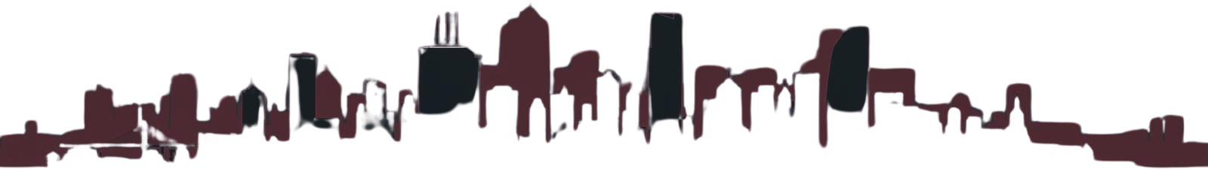



Machine Learning Project
AI WINE QUALITY
A FULL-STACK ML APPLICATION
PREDICTOR
Presenter
Kunal Verma
Shivam Prasad
Daksh Khatri
Lovenish Sharma
Akshit Sharma
[25BAI70432]
[25BAI70897]
[25BAI70806]
[25BAI70632]
[25BAI70679]

Slide 2


Problem Statement
Traditional machine learning projects often remain trapped in Jupyter notebooks—impressive in isolation but disconnected from real-world applications. Wine quality prediction models exist, but they lack the usability needed for practical deployment.
The Challenge
How do we bridge the gap between ML research and production-ready systems?
Users need intuitive interfaces, not code cells. Businesses need reliable predictions, not experimental notebooks. The industry demands full-stack MLOps solutions.

Slide 3
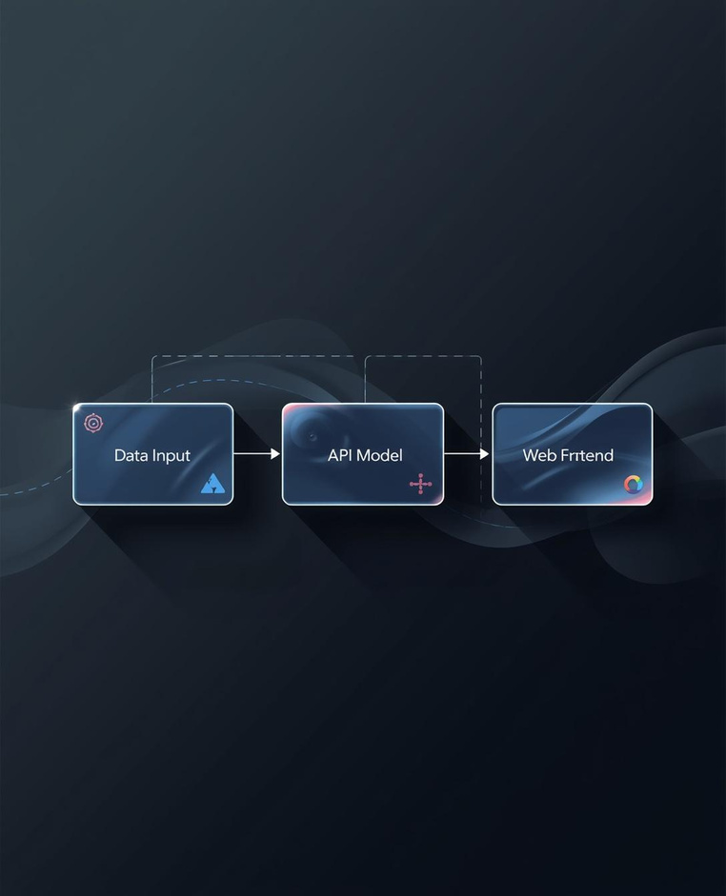
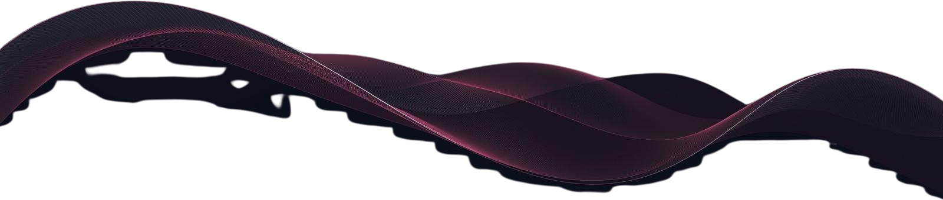

The Solution
Our AI Wine Quality Predictor delivers a complete end-to-end full-stack system that seamlessly integrates machine learning with production-ready web deployment. The architecture combines intelligent prediction capabilities with actionable recommendations.
Prediction Engine
Web Interface
Hybrid ML model combining RandomForest classification and regression for accurate quality scoring.
Modern, responsive UI with interactive sliders, real-time validation, and dynamic results display.
Recommendation System
MLOps Pipeline
Intelligent feature suggestion engine that guides users toward desired wine quality targets.
Streamlined deployment workflow with model packaging, versioning, and live cloud hosting on Render.

Slide 4

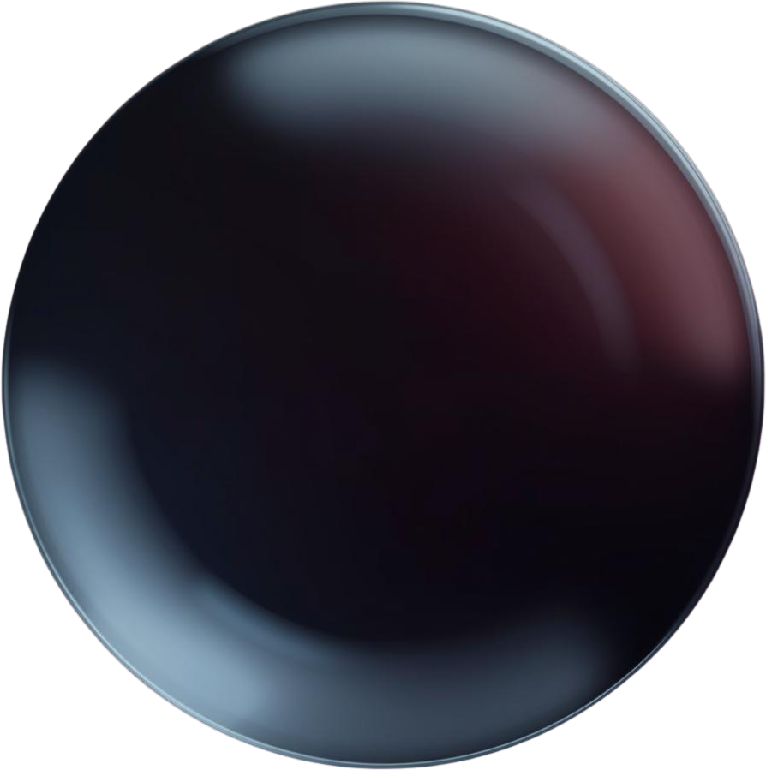
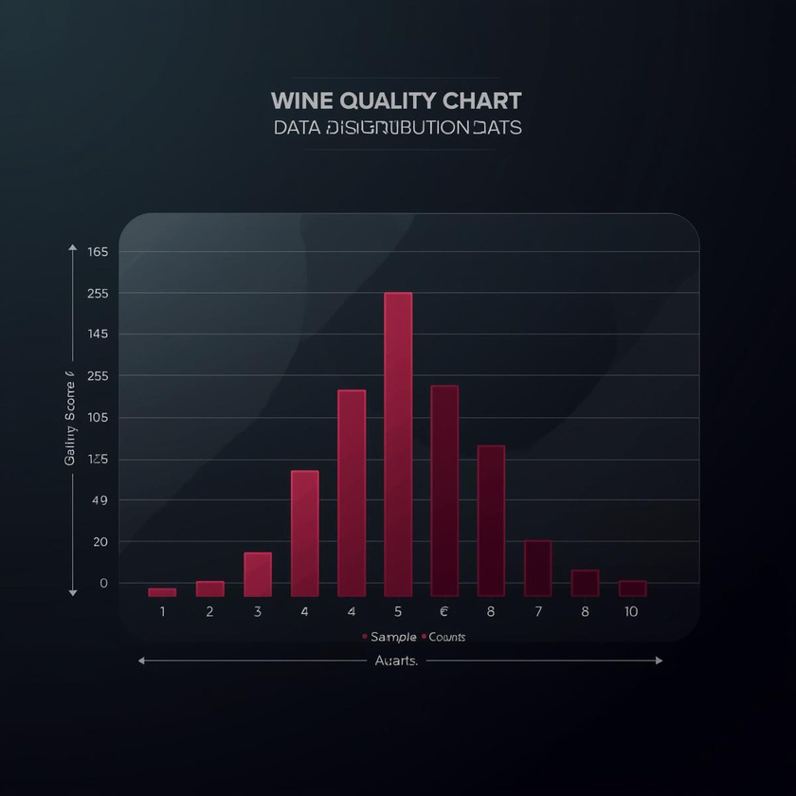


Data & Preprocessing
Our model leverages the UCI Wine Quality Dataset containing approximately 7,600 samples of red and white wine variants. Each sample includes 11 physicochemical features: fixed acidity, volatile acidity, citric acid, residual sugar, chlorides, free sulfur dioxide, total sulfur dioxide, density, pH, sulphates, and alcohol content.
Data Cleaning
Feature Scaling
Duplicate entries were identified and removed to ensure data integrity. Missing values were handled through systematic imputation, and outliers were detected using statistical methods to maintain dataset quality for model training.
StandardScaler normalization applied to all 11 features ensuring zero mean and unit variance. This preprocessing step is critical for model convergence and consistent prediction performance across varying input ranges.

Slide 5

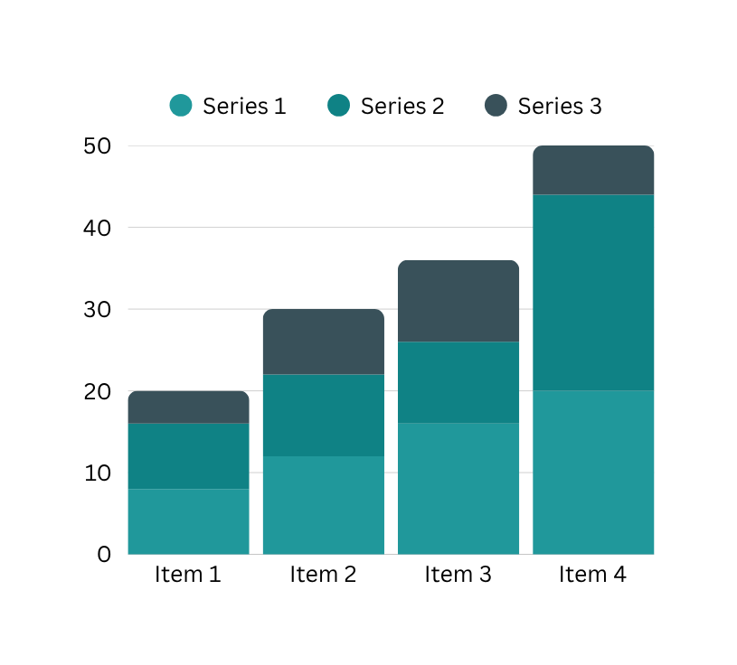


Addressing Class Imbalance
Data Distribution
The dataset exhibits significant skew toward "medium quality" wines (scores 5-6), comprising ~82% of samples. This imbalance risks model bias toward majority classes, reducing prediction accuracy for exceptional or poor wines.
Solutions implemented:
SMOTE (Synthetic Minority Oversampling) to generate synthetic samples for underrepresented classes, class weighting in RandomForest to penalize misclassification of minority classes, and stratified train-test splits to preserve distribution.

Slide 6
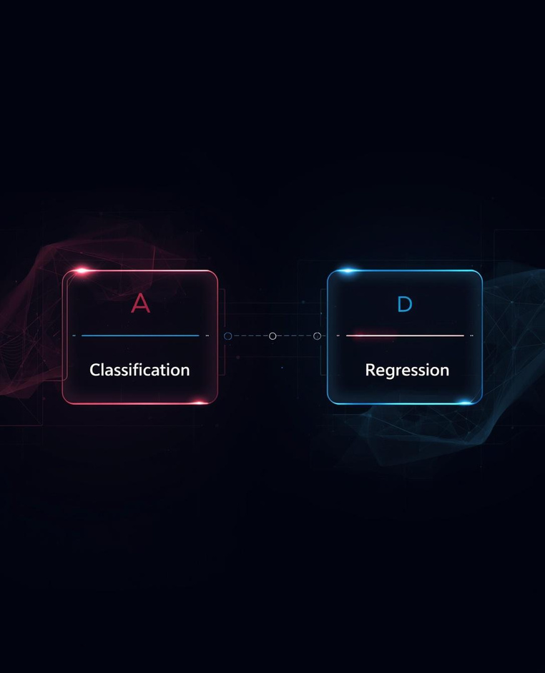

Hybrid Model Architecture
Our prediction system employs a sophisticated two-step hybrid approach, combining classification and regression models to deliver both categorical quality assessments and precise numeric scores for comprehensive wine quality analysis.
RandomForest Classifier
Feature Engineering
Categorizes wines into Low, Medium, and High quality tiers using ensemble decision trees.
Optimized 11 physicochemical features including alcohol content, acidity levels, and sulfur compounds.
Weighted Regressor
Ensemble Strategy
RandomForestRegressor with sample weighting to predict precise numeric quality scores (0-10).
Combined outputs from both models provide robust predictions with confidence intervals.

Slide 7

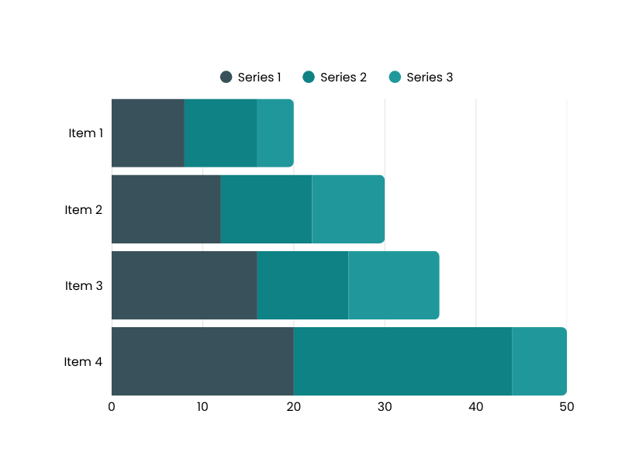
Performance Metrics (Notebook)
Comprehensive evaluation of our hybrid model architecture reveals strong predictive performance across all quality categories. The feature importance analysis highlights alcohol content and volatile acidity as key predictors of wine quality scores.
Accuracy
Precision
Recall
F1-Score

Slide 8

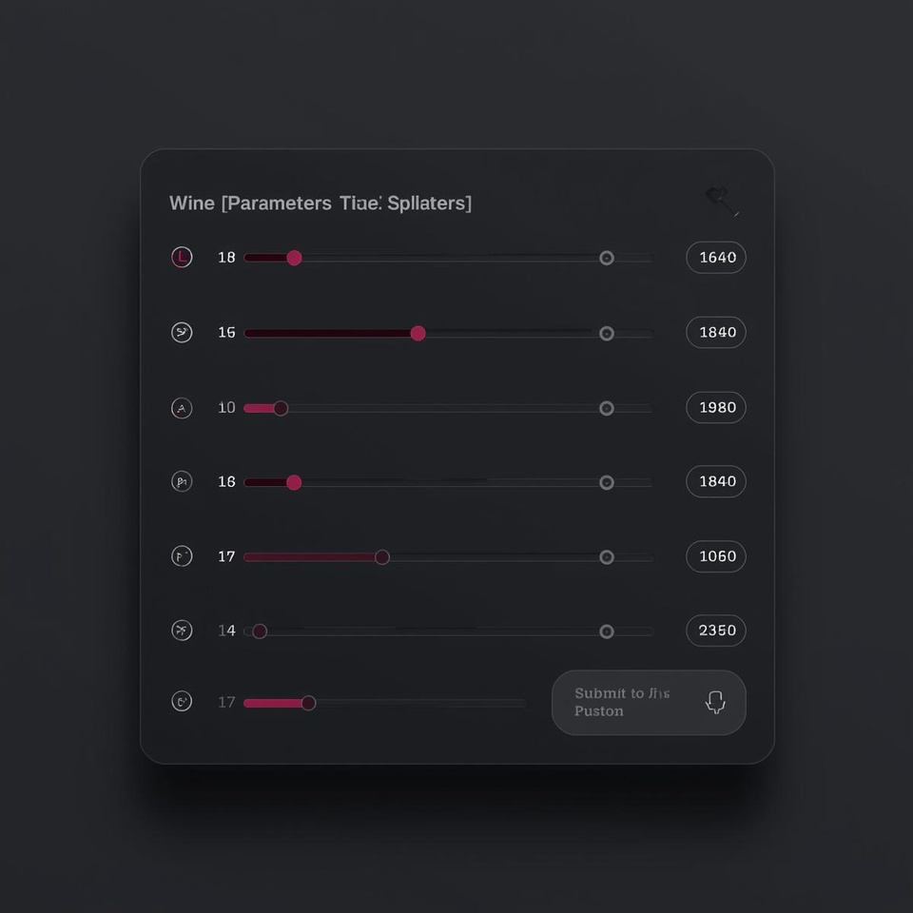


The Live Application (Frontend)
Our modern web interface delivers an intuitive user experience with interactive sliders for each physicochemical feature, real-time dynamic value displays, and comprehensive input validation. Users can easily adjust parameters like alcohol content, acidity levels, and sulfur dioxide concentrations while receiving instant visual feedback on their selections.
Sliders
Validation
Display
Submit

Slide 9

Advanced Feature: Decision Support
Target Quality Selection
Users specify their desired wine quality rating (3-9 scale), and the recommendation engine reverse-engineers the optimal input parameters needed to achieve that target quality level.
Feature Suggestions
The "Desired Quality Generator" analyzes current wine parameters and recommends specific adjustments to physicochemical features like alcohol content, acidity levels, and sulfur dioxide concentrations to move toward the target quality score.
Optimization Guidance
Provides actionable, prioritized recommendations ranked by impact and feasibility, helping winemakers understand which parameters to adjust first for maximum quality improvement.

Slide 10


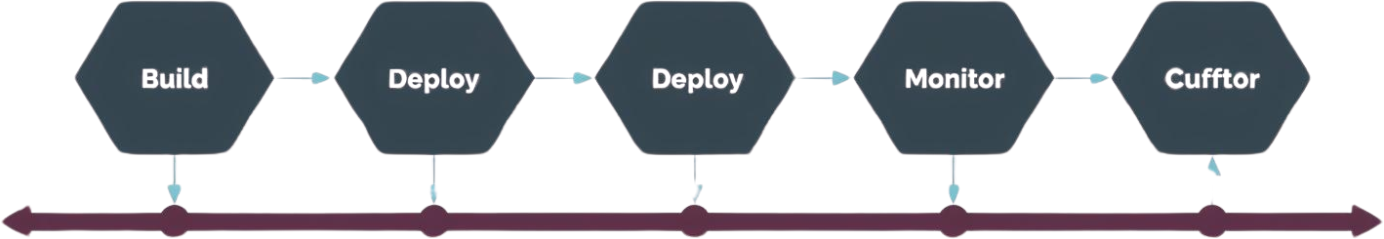


Deployment & MLOps
Our production pipeline transforms notebook experiments into a robust, maintainable system. The build_model.py script orchestrates training and serializes models using .joblib packaging for efficient loading. Backend restructuring separates concerns into modular components, enabling seamless updates and version control.
build_model.py
Backend Restructure
.joblib Packaging
Live on Render

Slide 11
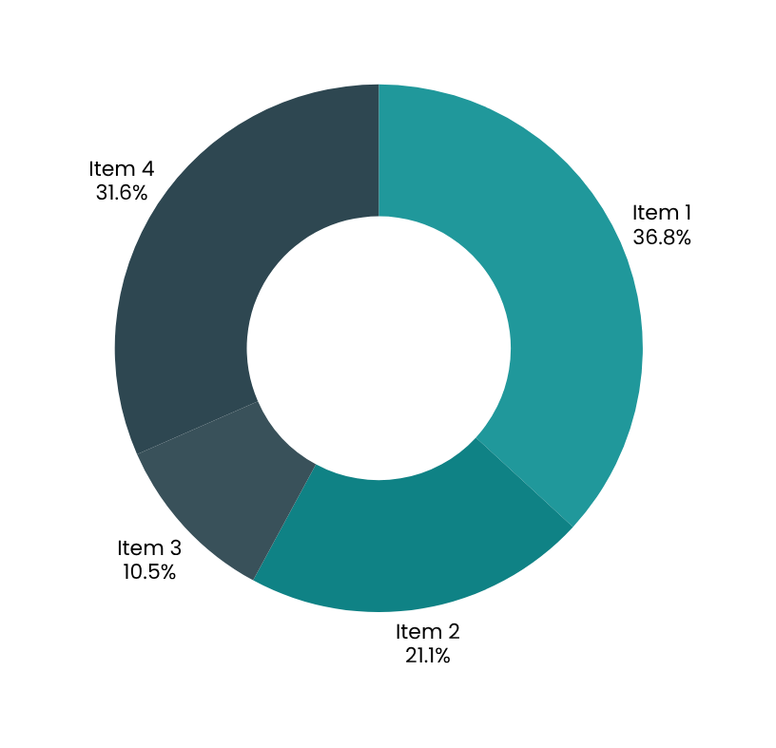

Future Work & Extensibility
The AI Wine Quality Predictor is designed for growth. Our roadmap includes RESTful API development for third-party integration, deep learning exploration with neural networks, expanded datasets covering diverse wine regions, and mobile app development for on-the-go predictions.
Contribute on GitHub
Join our open-source community to contribute new features, improve model accuracy, or help expand our training datasets. Every contribution moves us closer to production excellence.

Slide 12





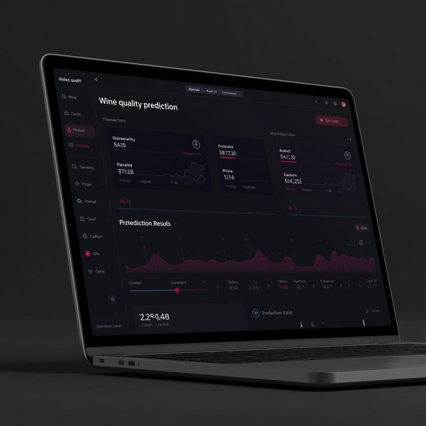

AI Wine Quality Predictor
THANK
YOU
Try the Live Demo
wine-quality-predictor-hn1v.onrender.com

